Slide 1
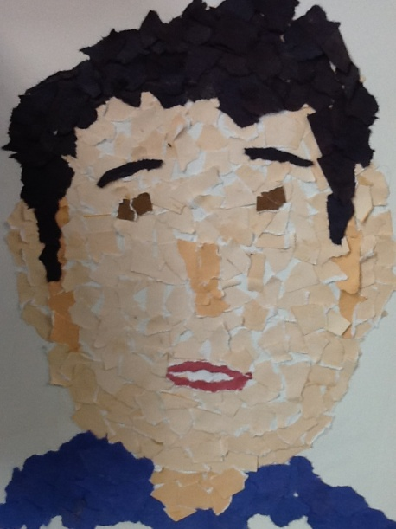
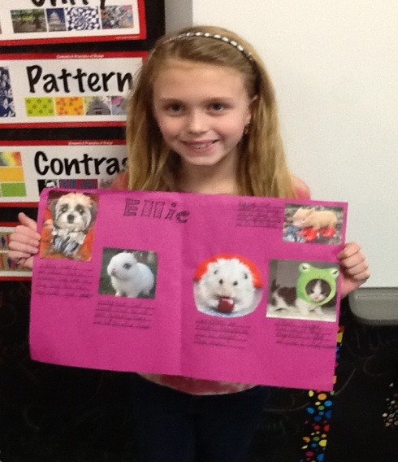
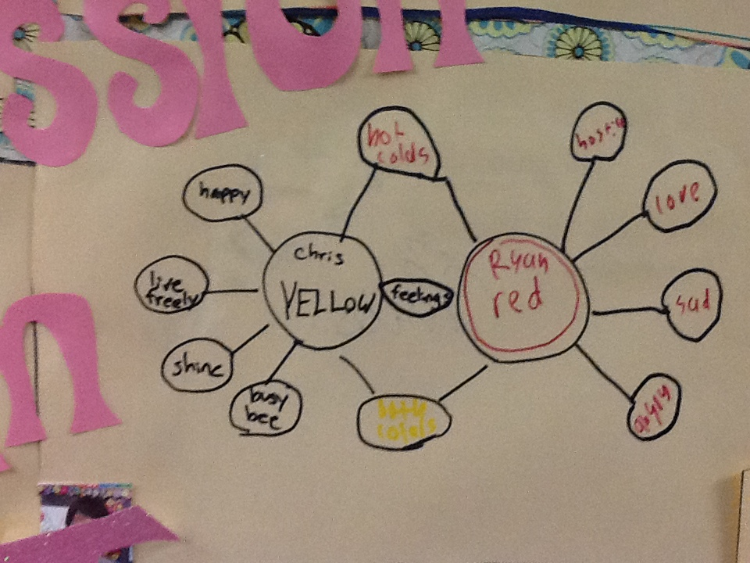
GT Services
Gifted & Talented
Grade Level service plan
For
2013-2014

Slide 2
Gifted and Talented Goals and Objectives
Texas State Plan for the Education of Gifted and Talented
In 1990, the State Plan for the Education of Gifted/Talented Students was adopted by the Texas State Board of Education and revised in 2009. The most significant revision was very simple. Instead of qualifying students for a GT Program, students now qualify for GT Services. The State Plan forms the basis of GT services and accountability in LISD.

Slide 3
State Goal for Gifted/Talented Student Services
Students who participate in services designed for gifted/talented students will demonstrate skills in self-directed learning, thinking, research, and communications as evidenced by the development of innovative products and performances that reflect individuality and creativity and are advanced in relation to students of similar age, experience, or environment.

Slide 4
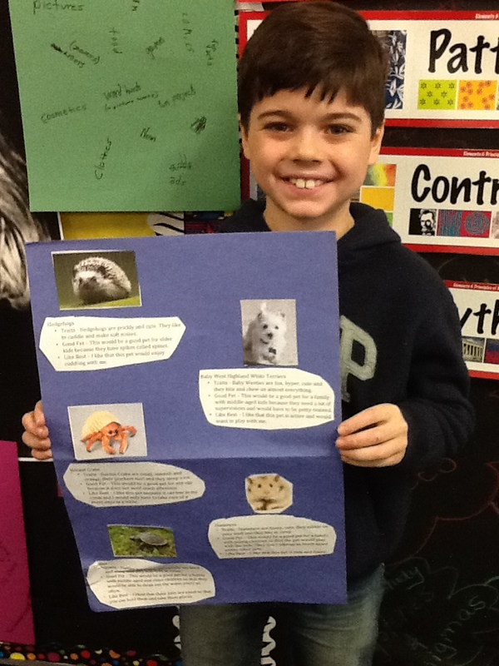
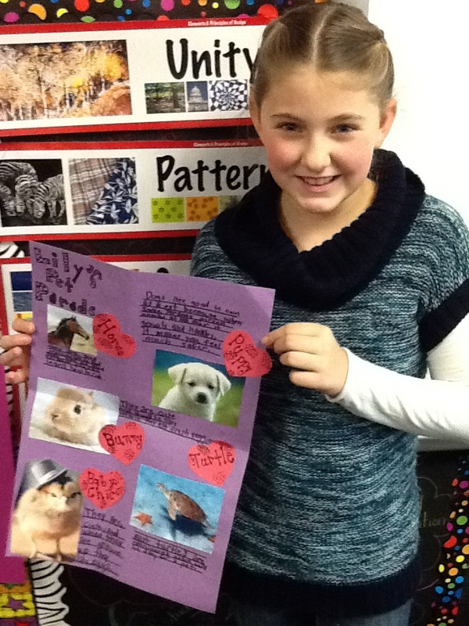
Critical, Logical and Creative Problem Solving

Slide 5
Mission & Objectives
LISD Gifted and Talented Mission
Through the establishment of secure and free learning environments, LISD GT students continuously seek out challenges to:
1. Promote scholarly behaviors that discover, develop and leverage capacity (Research)
2. Effectively communicate and collaborate
3. Foster critical thinking by manipulating abstract ideas and making deep connections
4. Promote creativity and innovation
5. Develop self awareness and social consciousness
LISD GT Goals and Objectives
The Gifted student will:
· Become aware of his or her own unique potential and leaning style in order to develop these abilities for the betterment of self and society.
· Utilize higher level thinking skills to develop intellectual curiosity in critical, creative and productive thinking.
· Understand and apply the problem-solving process in a cooperative group setting through analysis and evaluation of a real life situation.
· Develop reference skills for using multiple concepts and resources in synthesizing an advanced product.

Slide 6
GT Personnel
LISD Administration
The LISD School Board and the LISD district administration ensure that student assessment and services for gifted/talented students comply with the Texas State Plan for the Education of Gifted/Talented. All administrators and counselors who have authority for program decisions must have a minimum of 6 hours GT professional development that includes the nature and needs of GT students and a minimum of 6 hours annual professional development in GT education.
Hicks Elementary School Gifted and Talented Services
The campus GT Facilitator is responsible for campus compliance with the Texas State Plan for Education of GT Students, including GT identification, services delivery, ongoing assessment, staff professional development, and family/community communication. The campus GT Facilitator must have a minimum of 30 hours professional development that includes the nature and needs of GT students and a minimum of 30 hours annual professional development in GT education.
Lori Yoakam, GT Facilitator
Tom Hicks Elementary
yoakamlp@lisd.net
GT Cluster Classroom teachers are responsible for providing differentiated curriculum as needed, with support from the campus GT facilitator. All GT Cluster Classroom teachers must have a minimum of 6 hours professional development that includes the nature and needs of GT students and a minimum of 6 hours annual professional development in GT education. Identified Hicks GT students will be placed in a grade level GT Cluster Classroom with a minimum of two other GT students.

Slide 7
LISD GT Identification
What are Gifted and Talented Services?
Gifted and Talented Services (GT) provide academic enrichment services for identified students demonstrating superior intellectual giftedness through standardized aptitude and achievement tests, as well as GT characteristics scales, classroom Planned Experiences, and classroom work.
Who can request GT identification testing?
Testing can be requested by anyone throughout the school year. Students in grades K-2 are encouraged to wait until their GT Planned Experiences and/or non verbal assessments indicate GT testing readiness. Students identified as GT in other public school districts, who can provide acceptable testing documentation, will begin GT Services as soon as their documentation is received and approved by the district.
How will the GT testing be administered?
If you give permission, your student will be pulled out of the regular classroom for 6-9 small group testing sessions during a six week testing round. Testing sessions are arranged between the GT facilitator and the classroom teacher and will not exceed one hour in length.
How will my student qualify for GT Services?
After the tests are complete, the facilitator will compile a data sheet (profile), review results with a campus selection committee, and forward service recommendations to the district screening committee for review and placement recommendations.

Slide 8
Identification continued
How will I be notified of the GT identification testing results?
At the end of the testing round, after the district selection committee has met, you will receive a sealed letter informing you of their placement recommendation. If your student qualifies for GT Services, they will receive a GT Services Plan and begin receiving GT services as soon as an enclosed Permission to Serve form has been returned. If your student does not qualify, they must wait at least one year before retesting.
If my student qualifies for GT Services, how will they be served?
GT Services are designed to develop critical and creative thinking skills, problem solving skills, and reference skills for students demonstrating gifted abilities. The specific services each student receives vary, depending on the student’s placement recommendation and emerging educational, social, and emotional needs.
How do I start the GT identification process?
Complete a GT Testing Referral form and return to Mrs. Yoakam, GT Facilitator. These forms are available during the school year on our shared Leap/ GT Services folder or through your student’s classroom teacher.

Slide 9
Gifted and Talented Characteristics
Students with gifted and talented abilities often display some of the following characteristics:
1. Advanced Language
Uses advanced language compared to peers. Enjoys telling detailed stories. Has large storehouse of information and extensive vocabulary. Expressive. Makes comparisons to explain relationships.
2. Analytical Thinking
Has a high level of problem solving and reasoning skills. Aware. Observes surroundings intensely and is attentive to details in the environment. Understands complex ideas and thoughts. Sees patterns. Thinks deeply.
3. Meaning Motivation
Curious. Asks questions to make sense of rules and relationships. Generates original solutions to problems. Persistent in areas of interest. Creates unique products and innovations. Makes unexpected connections.
4. Perspective
Understands different points of view. Insightful. Values fairness. Sees the “bigger picture.” Creative when solving problems or looking for solutions. Demonstrates complex perspective in work.
5. Sense of Humor
Understands and uses subtle nuances of language. Highly creative, fun loving, witty. Experiments with language figuratively for humorous effect. Unusual imagination.
6. Sensitivity
Empathetic. Internalizes others feelings and emotions. Shows awareness of problems that others may not recognize. Exhibits concern for world issues. Cares deeply. Extensive memory about people and conversations.
7. Accelerated Learning
Learns quickly. Large storehouse of information. Sees patterns in procedures, experiences, ideas. Sees logical and common sense answers. Performs better with more challenging or complex tasks.

Slide 10
Gifted and Talented Referral
Date of Referral _______________________________
Student Name ________________________________ Student ID Number ______________
Campus: ________________
Classroom Teacher ____________________________ Grade ________________________
Name of person referring student for GT testing ______________________________________
Relation to student_____________________________________________________________
How long have you known this student? ____________
Please explain why you feel this student should be assessed for Gifted and Talented Services.
____________________________________________________________________________________________________________________________________________________________
__________________________________________________________________________________________________________________________________________________________________________________________________________
Provide examples of behaviors or characteristics of giftedness you have seen displayed by this student. Be specific.
______________________________________________________________________________________________________________________________________________________________________________________________________________________________________________________________________________________________________________________________________________________________________________________________________
Additional Comments ______________________________________________________________________________________________________________________________________________________________________________________________________________________________________________________________________________________________________________________________________________________________________________________________________
Referred students will be assessed during the next available testing round.
Results will be sent home approximately six weeks after testing begins.

Slide 11
Kinder Service Plan
All students are automatically considered for gifted/talented and other advanced level services. All students will receive the following services:
Classroom teachers with a minimum of 6 hours GT training
4 planned learning experiences, lead and assessed by GT facilitator in regular classroom
Non verbal ability assessment in January
Curriculum differentiation as needed.

Slide 12
First Grade
All students will receive the following GT services:
Classroom teacher with a minimum of 6 hours GT training
3 LISD planned experiences, lead and assessed by GT Facilitator in regular classrooms
Curriculum differentiation as needed
Students with evidence of emerging GT potential in Kindergarten Planned Experiences and/or non verbal ability assessment will be placed in 1st Grade GT cluster classroom at the beginning of the school year. Near the end of 1st grade, parents of students with evidence of GT potential and testing readiness will be notified of opportunities for GT identification testing.

Slide 13
Second Grade
All students will receive the following GT services:
Classroom teacher with a minimum of 6 hours GT training
2 LISD planned learning experiences, Lead and assessed by GT Facilitator in regular classroom
Curriculum differentiation as needed
Opportunities for GT testing throughout the year
Identified GT students will receive individualized GT service plans and be placed in a GT cluster classroom at the beginning of the year.

Slide 14
Third, Fourth and Fifth Grade
All students will receive the following GT services
Curriculum differentiation as needed
Opportunities for GT identification testing throughout the year

Slide 15
Identified Gifted and Talented Students Second - Fifth
Identified GT students will receive an annual individualized GT service plan, designed by the campus GT facilitator with input from the student’s parent/guardians and classroom teacher. The plan will indicate the GT services that will be provided to best meet the student’s educational, social, and emotional needs. Services may be adjusted at the end of the semester and/or school year if needs change.

Slide 16
Hicks GT Curriculum and Instruction
Planned Experiences: K-2 Classroom
Planned Experiences are lessons designed to develop and reveal advanced creative and critical thinking skills. They are presented and assessed by the campus GT facilitator in grade level classrooms. All Hicks K-2 grade students participate in Planned Experiences throughout the school year. Students with products that indicate emerging GT potential will be monitored by the GT facilitator and the classroom teacher for curriculum differentiation needs.
LISD and TPSP Research Projects: Grades 3-5 Pull Out
LISD Project Based Learning and Texas Performance Standards Projects (TPSP) are nine week, advanced level research units, designed to develop sophisticated products and/or performances in areas of interest for a targeted audience. Topics include the following:
Grade 3 Expressions, Media Analysis, Unsolved Mysteries, Surviving Disasters
Grade 4 Overcoming Adversity, Signs & Symbols, Design, More Bang for My Buck
Grade 5 Perceptions of Self, Leaders & Communication, Innovations,
Make a Difference

Slide 17
PLANNED LEARNING EXPERIENCES

Slide 18
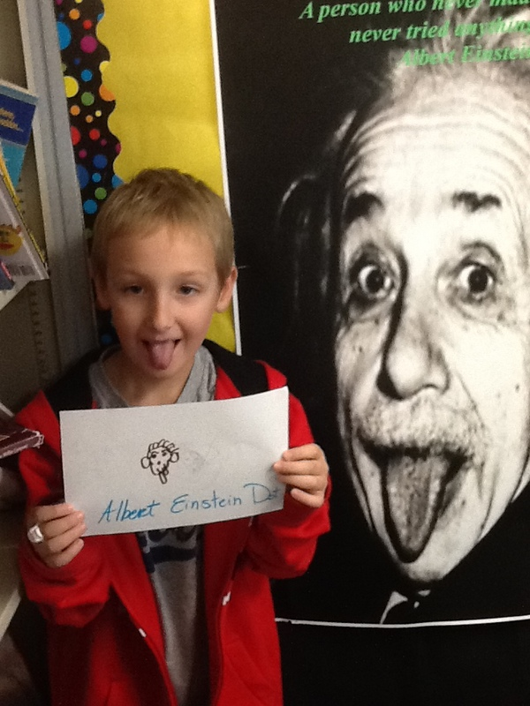
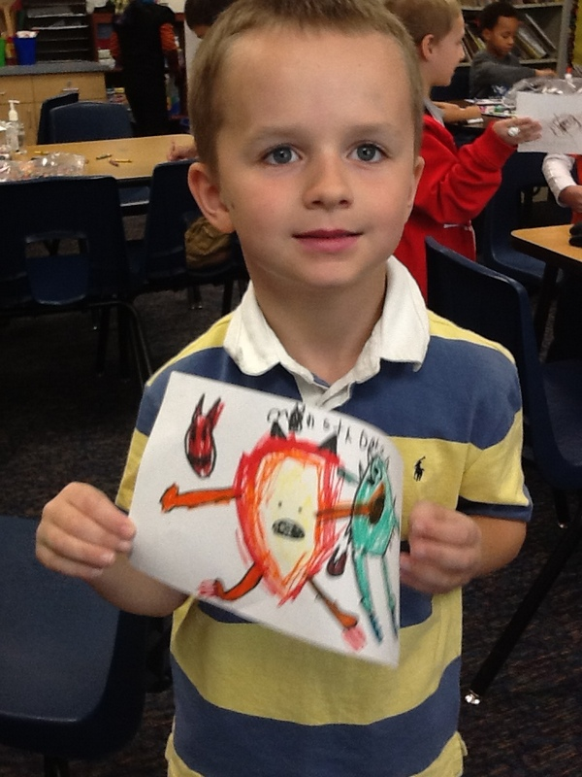
Planned Learning Experiences

Slide 19
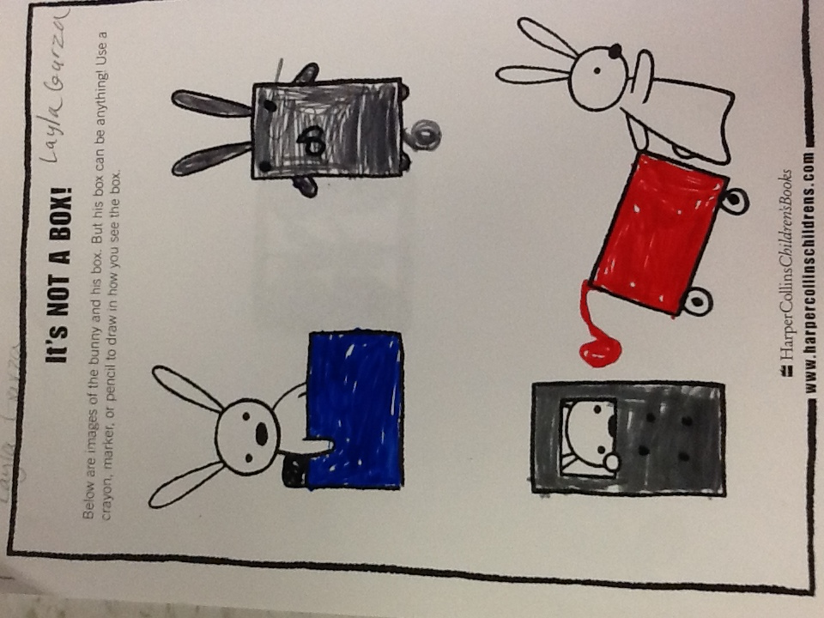
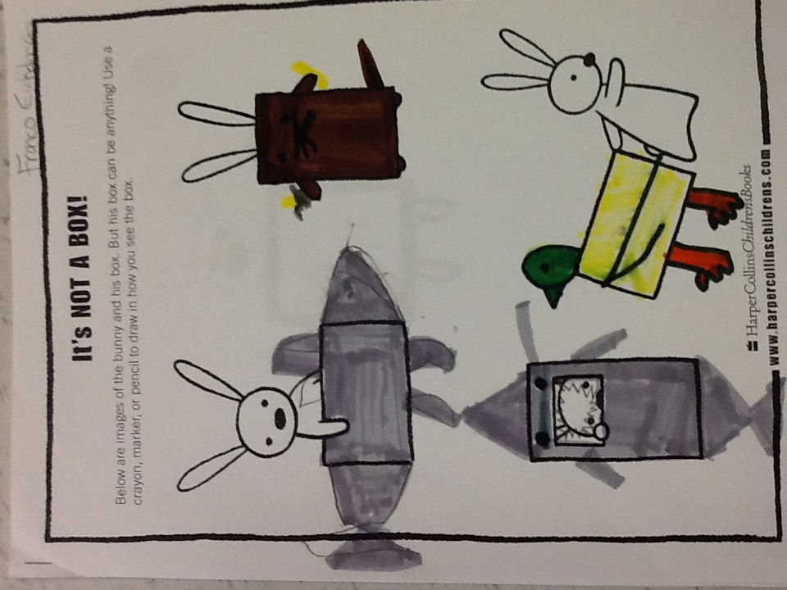
Planned Learning Experiences

Slide 20
Grade K-2 Students
Classroom progress and work will be continually assessed for differentiation needs by the classroom teacher and the GT facilitator. Portfolios of work samples, Planned Experience products, and non verbal testing results will be created and monitored for students with evidence of potential GT ability by the campus GT facilitator.
Grades 2-5 Identified Gifted and Talented Students
GT Services Plan
All identified GT students in grades 2-5 will receive a Gifted and Talented Services Plan at the beginning of the year. The GT facilitator will determine the specific services that each student receives, based on identification test results, student interest and ability, student development, classroom teacher recommendations, and parent/guardian input.
Regular Classroom Work
Classroom progress and work will be continually assessed for differentiation needs by the classroom teacher and GT facilitator. Students receiving GT services are expected to maintain an 80% or higher grade average in their core classroom subjects. Students who fall below 80% in grade level work will be placed on a GT Probation Plan until their classroom work returns to acceptable standards. The terms of the Probation Plan will be determined by the campus GT facilitator, the student’s parents/guardians, the student, and campus administration.
GT Portfolios
All identified GT students will maintain a portfolio of their GT work, final products, assessments, and progress reports. Final products and/or performances will be assessed by the student, peers, and the GT facilitator using research, product, and/or presentation rubrics. Portfolios will be sent home every six weeks for parent review.
GT Report Cards
LISD GT report cards, designed to assess gifted capacities, will be sent home every six weeks for parent/guardian review. In addition, campus progress reports designed to assess student progress in GT Services will be sent home at the end of every semester for parent/guardian review.
GT Stakeholders
All stakeholders, including GT students, their families and community, campus staff, and administration, will have opportunities for involvement in the services designed for GT students throughout the school year. Examples of these opportunities include project presentations to targeted audiences, community mentorships, information meetings, campus staff team planning, surveys, and individual conferences.

Slide 21
Third Grade Overview

Slide 22
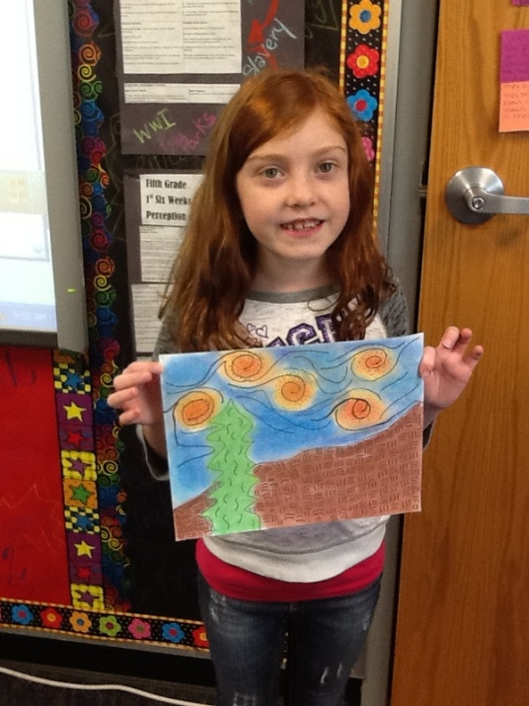
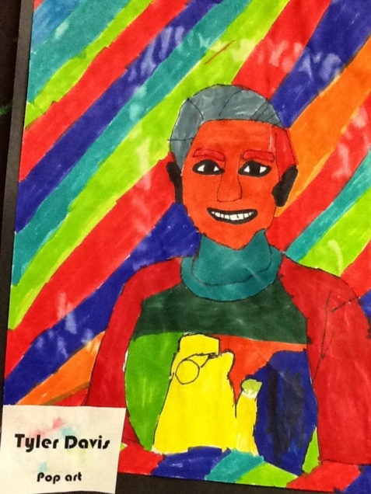
3rd Grade

Slide 23
Fourth Grade Overview

Slide 24
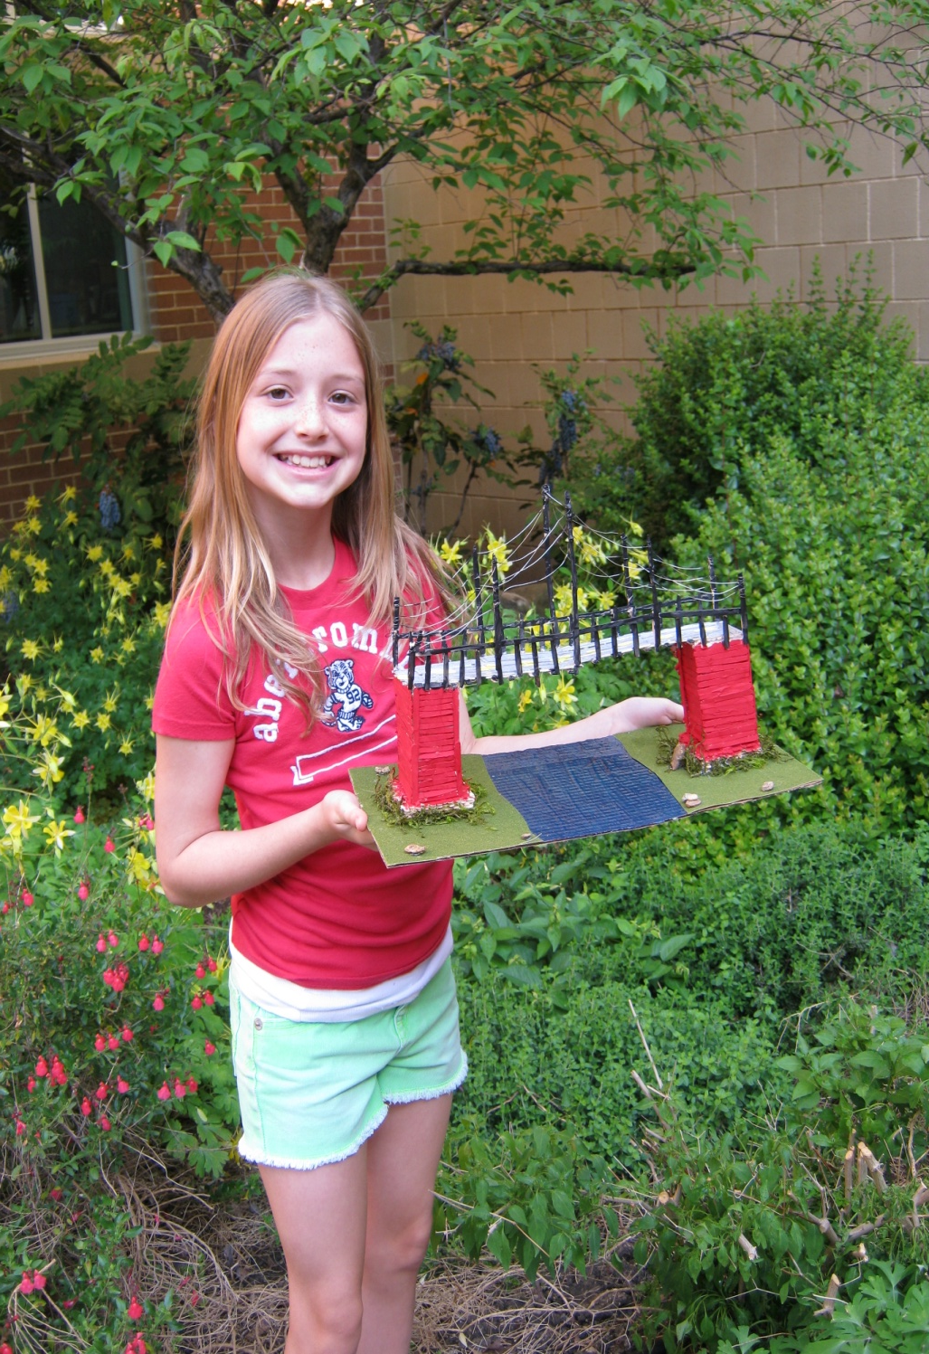
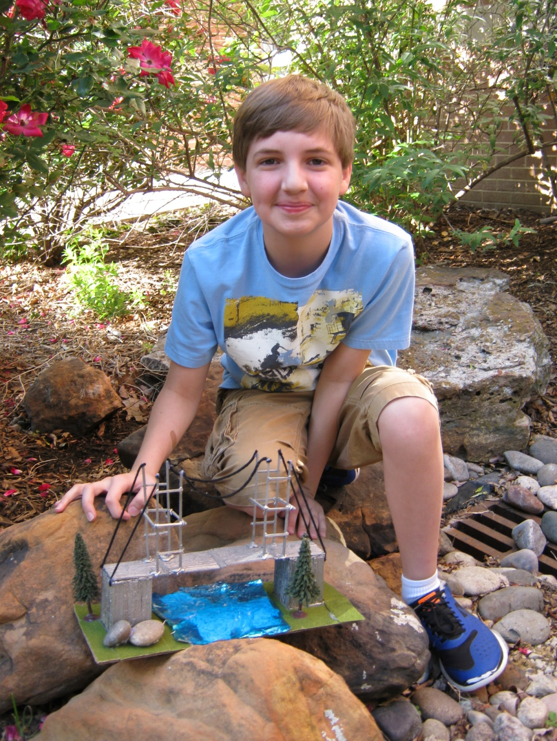

Slide 25
Fifth Grade Overview

Slide 26
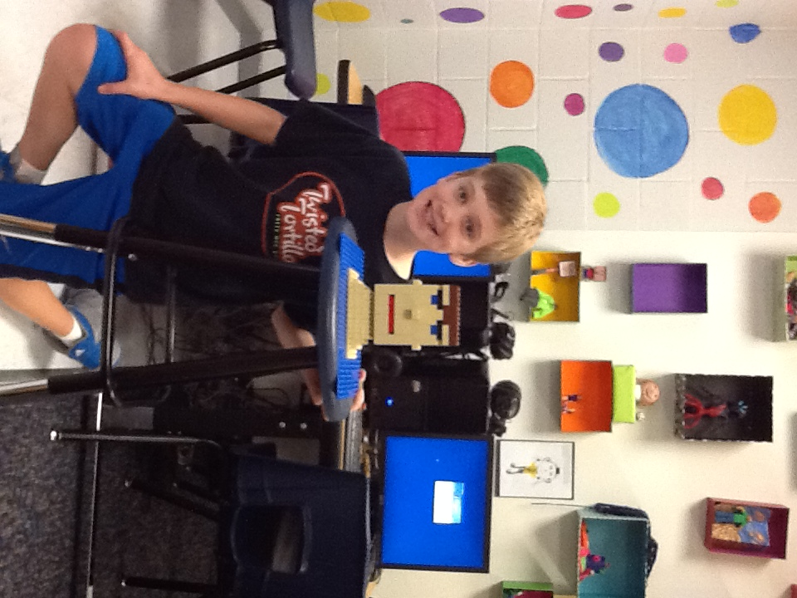
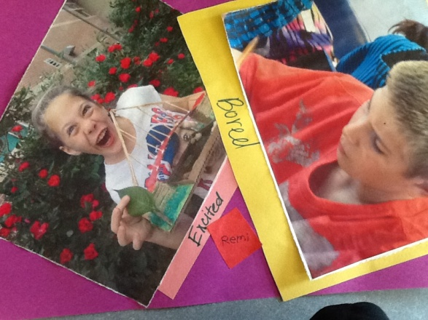
5th GRADE

